Slide 1

Qualitative Research By Andrew R. Smolski, Department of Sociology and Anthropology

Slide 2
Write-to-Think Exercise
To begin with, take out a pen and paper. Or, you can use your computer if you like.
How do you conduct qualitative research? What types of data are qualitative? Why would you use qualitative methods?
Take a few minutes to think about these questions. Then, we will share together.

Slide 3
What is qualitative Research?
Focus on details, description, experience, narrative
Can be ideographic – concerned with the study of meaning, how we produce meaning, how meaning affects our decisions
Concerned with both general pattern and exception to the rule

Slide 4




Qualitative Methodologies
Symbolic Interaction
Bottom-up
Meaning evolves from contestation and development between participants
Data collected from everyday life

Slide 5
Qualitative Methodologies
Holism, Value-Orientation and the Grille
Top-down
Meaning is structured by institutions and paradigms
Data collected from artifacts, but also from interviews, etc.

Slide 6
Question Break
Do you have any questions about the abstract assumptions underlying qualitative research?

Slide 7
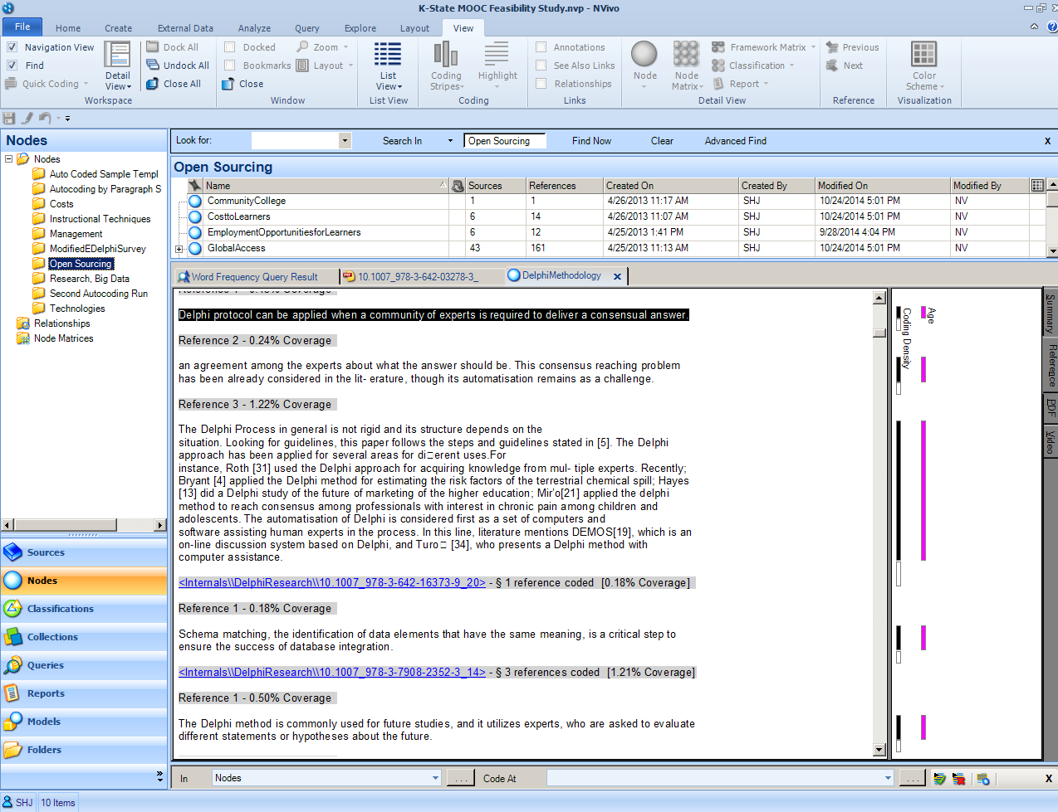
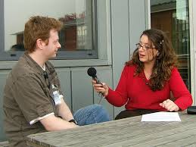
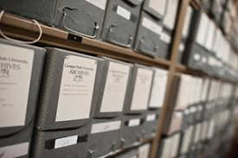
Types of qualitative methods
In-depth interviews
Data – Transcribed and coded interviews
Comparative Historical Analysis
Data – Primary sources are archives and private collections, secondary sources are historiographies
Content Analysis
Data – Newspapers, magazines, flyers, etc.
Ethnography
Data – field observations, participation, etc.

Slide 8
Interview Research Process
Informed Consent
Institutional Review Board
Key Informants
Establishing presence in research site and making connections
Interview Protocols
Semi-structured
Following leads during interview
Notes and Memos
How do you divide up what is produced? How do you decide?
How do you divide up the profits? How do you decide?
How do you decide who does what job?
Do you think people are egoists? Altruistic? Why?

Slide 9
Content Analysis Process
Selecting Data Source
- Magazines, Newspapers, etc.
- TV Shows, Music, etc.
- Government Documents, etc.
Coding
- More on this in next slide
Deciding on a sample
- What is your time frame?
- How many are necessary for theoretical saturation?
Questions
What patterns arise from the data?
Do these patterns arise in all instances? Or do different patterns arise from different sets of artifacts?

Slide 10
Coding Qualitative Data
Open Coding
- Details
- Theoretical Notes
- As many codes as you feel represent different aspects of the data
Focused Coding
- Refine and reduce the number of codes
- Which codes overlap or analyze a similar phenomena
Frames
- Array codes into groups

Slide 11
Question Break
Do you have any questions about the qualitative research methods and data analysis techniques?

Slide 12
Workshop Activity
On the GitHub for this workshop, there is a file that contains a set of paragraphs. We are going to use these paragraphs to do a content analysis.
Open the file in Microsoft Word.
Read through each of the paragraphs to get an idea of what possible codes could fit. Write down these initial ideas.

Slide 13
Workshop Feedback
If you are able, I would appreciate feedback to help improve this workshop in the future. Please, go to this link to comment: http://go.ncsu.edu/pseval
Thanks for your participation today!

